Slide 1

ArrayLists
Chris Piech
CS106A, Stanford University

Slide 2
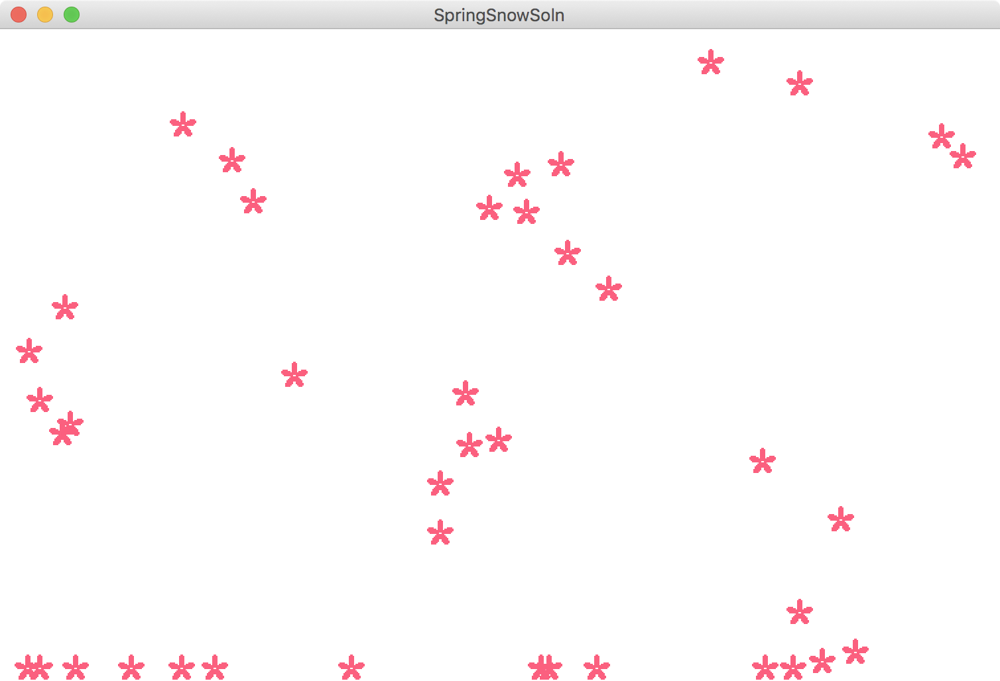
Why is this hard to write?

Slide 3
Why is this hard to write?

Slide 4
Arrays
int[] numbers = new int[5];
stack
heap
run
index | 0 | 1 | 2 | 3 | 4
value | 0 | 0 | 0 | 0 | 0
numbers

Slide 5
Arrays
int[] numbers = new int[5];
numbers[2] = 5;
stack
heap
run
index | 0 | 1 | 2 | 3 | 4
value | 0 | 0 | 0 | 0 | 0
numbers

Slide 6
Arrays
int[] numbers = new int[5];
numbers[2] = 5;
stack
heap
run
index | 0 | 1 | 2 | 3 | 4
value | 0 | 0 | 5 | 0 | 0
numbers

Slide 7
Arrays
int[] numbers = new int[5];
numbers[2] = 5;
println(numbers[2]);
stack
heap
run
index | 0 | 1 | 2 | 3 | 4
value | 0 | 0 | 5 | 0 | 0
numbers

Slide 8
What does this say?
5
3
A
A
B
3
0
5
)
)
6
*
;
4
8
2
6
)
4
A
K
)
4
A
)
;
8
0
6
*
;
4
8
B
8
X
6
0
)
)
8
5
;
1
A
(
;
:
A
*
8
B
8
3
(
8
8
)
5
*
B
;
4
6
(
;
8
8
*
9
6
*
?
;
8
)
*
A
(
;
4
8
5
)
;
5
*
B
2
:
*
A
(
;
4
9
5
6
*
2
(
5
*
–
4
)
8
X
8
*
;
4
0
6
9
2
8
5
)
;
)
6
B
8
)
4
A
A
;
1
(
A
9
;
4
8
0
8
1
;
8
:
8
A
1
;
4
8
B
8
5
;
4
)
4
8
5
B
5
2
8
8
0
6
*
8
1
(
A
9
;
4
8
;
(
8
8
;
4
(
A
?
3
4
;
4
8
)
4
A
;
1
6
1
;
:
1
8
8
;
A
?
;
Puzzle in Gold Bug by Edgar Allan Poe

Slide 9
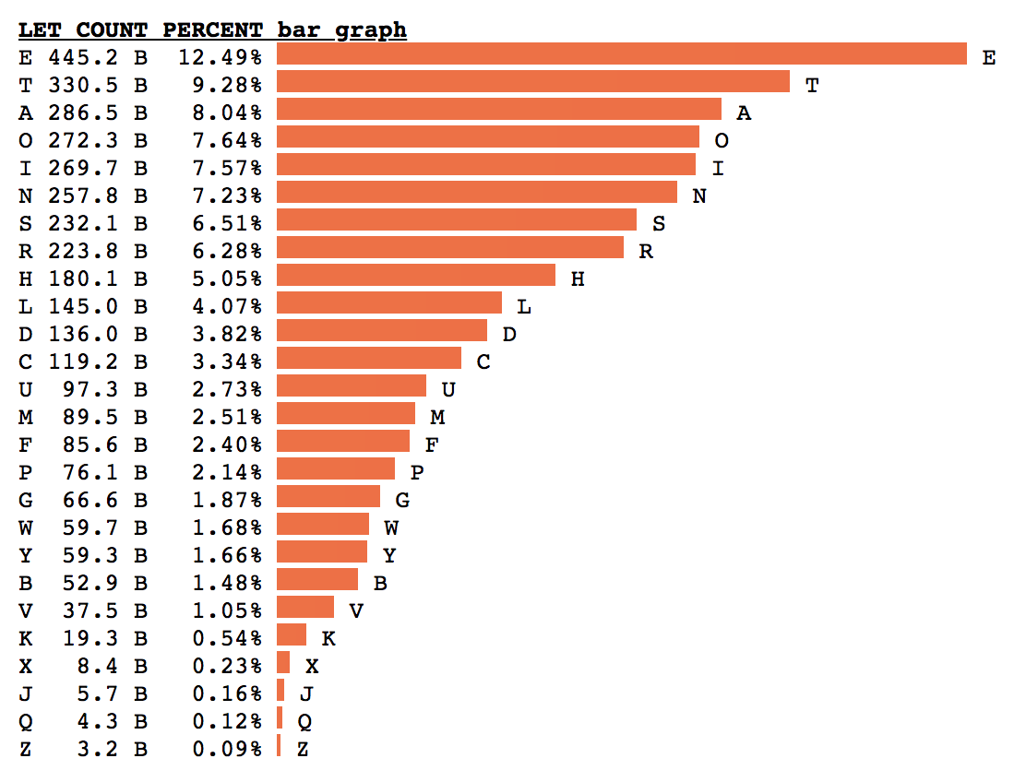
Letter Frequency
By Peter Norvig
Head of Google Research
Former CS221 Instructor
Based on 3.8 trillion letters

Slide 10
Implementation Strategy
The basic idea behind the program to count letter frequencies is to use an array to keep track of how many times each letter appears. As the program reads the text, it increments the array element that corresponds to each letter.
T
W
A
S
B
R
I
L
L
I
G
0
1
0
1
0
0
0
0
0
1
0
0
1
2
0
0
0
1
2
0
0
0
0
0
0
1
0
1
0
1
0
0
0
1
0
0
0
0
1
2
3
4
5
6
7
8
9
10
11
12
13
14
15
16
17
18
19
20
21
22
23
24
25

Slide 11
Recall Char
Notes:
11

Slide 12
Putting Data In An Array
To the code!

Slide 13
Poe’s Cryptographic Puzzle
5
3
A
A
B
3
0
5
)
)
6
*
;
4
8
2
6
)
4
A
K
)
4
A
)
;
8
0
6
*
;
4
8
B
8
X
8
33
6
0
)
)
8
5
;
1
A
(
;
:
A
*
8
B
8
3
(
8
8
)
5
*
B
;
4
6
(
;
8
8
*
9
6
*
;
26
?
;
8
)
*
A
(
;
4
8
5
)
;
5
*
B
2
:
*
A
(
;
4
9
5
6
*
2
(
5
*
–
4
)
8
X
4
19
8
*
;
4
0
6
9
2
8
5
)
;
)
6
B
8
)
4
A
A
;
1
(
A
9
;
4
8
0
8
1
;
8
:
8
A
A
16
1
;
4
8
B
8
5
;
4
)
4
8
5
B
5
2
8
8
0
6
*
8
1
(
A
9
;
4
8
;
(
8
8
;
4
(
)
16
*
13
A
?
3
4
;
4
8
)
4
A
;
1
6
1
;
:
1
8
8
;
A
?
;
5
12
6
11
(
10
B
8
1
8
0
6
9
5
5
2
5
5
5
A
3
3
3
G
A
A
A
O
A
A
A
O
B
B
B
D
3
3
3
G
0
0
0
L
5
5
5
A
)
)
)
S
)
)
)
S
6
6
6
I
*
*
*
N
;
;
T
T
4
4
H
H
8
E
E
E
2
2
2
B
6
6
6
I
)
)
)
S
4
4
H
H
A
A
A
O
K
K
K
P
)
)
)
S
4
4
H
H
A
A
A
O
)
)
)
S
;
;
T
T
8
E
E
E
0
0
0
L
6
6
6
I
*
*
*
N
;
;
T
T
4
4
H
H
8
E
E
E
B
B
B
D
8
E
E
E
X
X
X
V
6
:
4
6
6
I
0
0
0
L
)
)
)
S
)
)
)
S
8
E
E
E
5
5
5
A
;
;
T
T
1
1
1
F
A
A
A
O
(
(
(
R
;
;
T
T
:
:
:
Y
A
A
A
O
*
*
*
N
8
E
E
E
B
B
B
D
8
E
E
E
3
3
3
G
(
(
(
R
8
E
E
E
8
E
E
E
)
)
)
S
5
5
5
A
*
*
*
N
B
B
B
D
;
;
T
T
4
4
H
H
6
6
6
I
(
(
(
R
;
;
T
T
8
E
E
E
8
E
E
E
*
*
*
N
9
9
9
M
6
6
6
I
*
*
*
N
?
3
4
?
?
U
;
;
T
T
8
E
E
E
)
)
)
S
*
*
*
N
A
A
A
O
(
(
(
R
;
;
T
T
4
4
H
H
8
E
E
E
5
5
5
A
)
)
)
S
;
;
T
T
5
5
5
A
*
*
*
N
B
B
B
D
2
2
2
B
:
:
:
Y
*
*
*
N
A
A
A
O
(
(
(
R
;
;
T
T
4
4
H
H
9
9
9
M
5
5
5
A
6
6
6
I
*
*
*
N
2
2
2
B
(
(
(
R
5
5
5
A
*
*
*
N
–
–
–
C
4
4
H
H
)
)
)
S
8
E
E
E
X
X
X
V
?
3
8
E
E
E
*
*
*
N
;
;
T
T
4
4
H
H
0
0
0
L
6
6
6
I
9
9
9
M
2
2
2
B
8
E
E
E
5
5
5
A
)
)
)
S
;
;
T
T
)
)
)
S
6
6
6
I
B
B
B
D
8
E
E
E
)
)
)
S
4
4
H
H
A
A
A
O
A
A
A
O
;
;
T
T
1
1
1
F
(
(
(
R
A
A
A
O
9
9
9
M
;
;
T
T
4
4
H
H
8
E
E
E
0
0
0
L
8
E
E
E
1
1
1
F
;
;
T
T
8
E
E
E
:
:
:
Y
8
E
E
E
A
A
A
O
X
2
1
1
1
F
;
;
T
T
4
4
H
H
8
E
E
E
B
B
B
D
8
E
E
E
5
5
5
A
;
;
T
T
4
4
H
H
)
)
)
S
4
4
H
H
8
E
E
E
5
5
5
A
B
B
B
D
5
5
5
A
2
2
2
B
8
E
E
E
8
E
E
E
0
0
0
L
6
6
6
I
*
*
*
N
8
E
E
E
1
1
1
F
(
(
(
R
A
A
A
O
9
9
9
M
;
;
T
T
4
4
H
H
8
E
E
E
;
;
T
T
(
(
(
R
8
E
E
E
8
E
E
E
;
;
T
T
4
4
H
H
(
(
(
R
–
1
A
K
1
A
A
O
?
?
?
U
3
3
3
G
4
4
H
H
;
;
T
T
4
4
H
H
8
E
E
E
)
)
)
S
4
4
H
H
A
A
A
O
;
;
T
T
1
1
1
F
6
6
6
I
1
1
1
F
;
;
T
T
:
:
:
Y
1
1
1
F
8
E
E
E
8
E
E
E
;
;
T
T
A
A
A
O
?
?
?
U
;
;
T
T
Notes:
13

Slide 14
Putting Data In An Array
Imagine a better world….

Slide 15
ArrayLists

Slide 16
ArrayList
An ordered, resizable list of information
Homogeneous
Can add and remove elements (among other cool functionality)
Can store any object type
Requires importing java.util.*;
Notes:
An arraylist is like a variable container.

Slide 17
Our First ArrayList
ArrayList<String> myArrayList = new ArrayList<String>();
Notes:
This is how you declare a new ArrayList variable. It’s an OBJECT!

Slide 18
Our First ArrayList
ArrayList<String> myArrayList = new ArrayList<String>();

Slide 19
Our First ArrayList
Type of thing your ArrayList will store.
ArrayList<String> myArrayList = new ArrayList<String>();
Notes:
What type of thing are you going to store?

Slide 20
Our First ArrayList
ArrayList<String> myArrayList = new ArrayList<String>();

Slide 21
Our First ArrayList
ArrayList<String> myArrayList = new ArrayList<String>();

Slide 22
Our First ArrayList
Same type here, but followed by ().
ArrayList<String> myArrayList = new ArrayList<String>();

Slide 23
Our First ArrayList
ArrayList<String> myArrayList = new ArrayList<String>();
Notes:
So now that we’ve created an arraylist, what can we do with it? Lots! BINS

Slide 24
Our First ArrayList
ArrayList<String> myArrayList = new ArrayList<String>();
// Adds elements to the back
myArrayList.add(“hi”);
Notes:
We can add things to it

Slide 25
Our First ArrayList
ArrayList<String> myArrayList = new ArrayList<String>();
// Adds elements to the back
myArrayList.add(“hi”);
myArrayList.add(“there”);
Notes:
We can add things to it

Slide 26
Our First ArrayList
ArrayList<String> myArrayList = new ArrayList<String>();
// Adds elements to the back
myArrayList.add(“hi”);
myArrayList.add(“there”);
// Access elements by index (starting at 0!)
println(myArrayList.get(0)); // prints “hi”
println(myArrayList.get(1)); // prints “there”
Notes:
A few things to watch out for…

Slide 27
Our First ArrayList
ArrayList<String> myArrayList = new ArrayList<String>();
// Adds elements to the back
myArrayList.add(“hi”);
myArrayList.add(“there”);
// Access elements by index (starting at 0!)
println(myArrayList.get(0)); // prints “hi”
println(myArrayList.get(1)); // prints “there”
// Wrong type - bad times! Won’t compile
GLabel label = new GLabel(“hi there”);
myArrayList.add(label);
Notes:
Can only add the type of objects we said we would

Slide 28
Our First ArrayList
ArrayList<String> myArrayList = new ArrayList<String>();
// Adds elements to the back
myArrayList.add(“hi”);
myArrayList.add(“there”);
// Access elements by index (starting at 0!)
println(myArrayList.get(0)); // prints “hi”
println(myArrayList.get(1)); // prints “there”
// Wrong type - bad times! Won’t compile
GLabel label = new GLabel(“hi there”);
myArrayList.add(label);
// Invalid index – crashes! IndexOutOfBounds Exception
println(myArrayList.get(2));
Notes:
Can’t access elements that don’t exist!
ArrayLists’ indices work great with for loops!

Slide 29
Our First ArrayList
ArrayList<String> myArrayList = new ArrayList<String>();
// Adds elements to the back
myArrayList.add(“hi”);
myArrayList.add(“there”);
// Access elements by index (starting at 0)
for (int i = 0; i < myArrayList.size(); i++) {
String str = myArrayList.get(i);
println(str);
}
// hi
// there
Notes:
Can loop over every element in an Arraylist, kind of like a string. But you can change elements in an arraylist!
What else can you do with an ArrayList?

Slide 30
Our First ArrayList
ArrayList<String> myArrayList = new ArrayList<String>();
// Adds elements to the back
myArrayList.add(“hi”);
myArrayList.add(“there”);
// Access elements by index (starting at 0)
for (int i = 0; i < myArrayList.size(); i++) {
String str = myArrayList.get(i);
println(str);
}
// Beautiful way to access each element
for (String str : myArrayList) {
println(str);
}
Notes:
Can loop over every element in an Arraylist, kind of like a string. But you can change elements in an arraylist!
What else can you do with an ArrayList?

Slide 31
Methods in the ArrayList Class
boolean add(<T> element)
Adds a new element to the end of the ArrayList; the return value is always true.
void add(int index, <T> element)
Inserts a new element into the ArrayList before the position specified by index.
<T> remove(int index)
Removes the element at the specified position and returns that value.
boolean remove(<T> element)
Removes the first instance of element, if it appears; returns true if a match is found.
void clear()
Removes all elements from the ArrayList.
int size()
Returns the number of elements in the ArrayList.
<T> get(int index)
Returns the object at the specified index.
<T> set(int index, <T> value)
Sets the element at the specified index to the new value and returns the old value.
int indexOf(<T> value)
Returns the index of the first occurrence of the specified value, or -1 if it does not appear.
boolean contains(<T> value)
Returns true if the ArrayList contains the specified value.
boolean isEmpty()
Returns true if the ArrayList contains no elements.
Using portions of slides by Eric Roberts
Notes:
This all seems great! This must be too good to be true…

Slide 32
ArrayLists + Primitives = 💔
// Doesn’t compile ☹
ArrayList<int> myArrayList = new ArrayList<int>();
ArrayLists can only store objects!
Notes:
One caveat: can only store objects…
So what did Java do? Patch fix! They made *object versions of each primitive”
This seems hacky…..

Slide 33
ArrayLists + Primitives = 💔
Primitive | “Wrapper” Class
int | Integer
double | Double
boolean | Boolean
char | Character
Notes:
Java made object versions of primitives!

Slide 34
ArrayLists + Wrappers = ❤️️
// Just use wrapper class when making an ArrayList
ArrayList<Integer> numList = new ArrayList<Integer>();
numList.add(123);
numList.add(546);
int firstNum = numList.get(0); // 123
int secondNum = numList.get(1); // 456
Conversion happens automatically!
Notes:
Java takes care of the conversion for you!
Boxing and Unboxing
“Autoboxing”
DEMO

Slide 35
lets see a simple example.

Slide 36
Data Structures
Operation | Arrays | ArrayListss
Make a new one | int arr = new int[5]; | ArrayList<String> list = new ArrayList<String>();
Get length? | arr.length | list.size();
Get element? | arr[i] | list.get(i);
Set element? | arr[i] = 5; | list.set(i, value); list.add(value);
Loop? | for(int i = 0; i < arr.length; i++) | for(String value : list)

Slide 37
Winter is over
Thanks Keith Schwarz for some great slides to build off!

